Slide 1
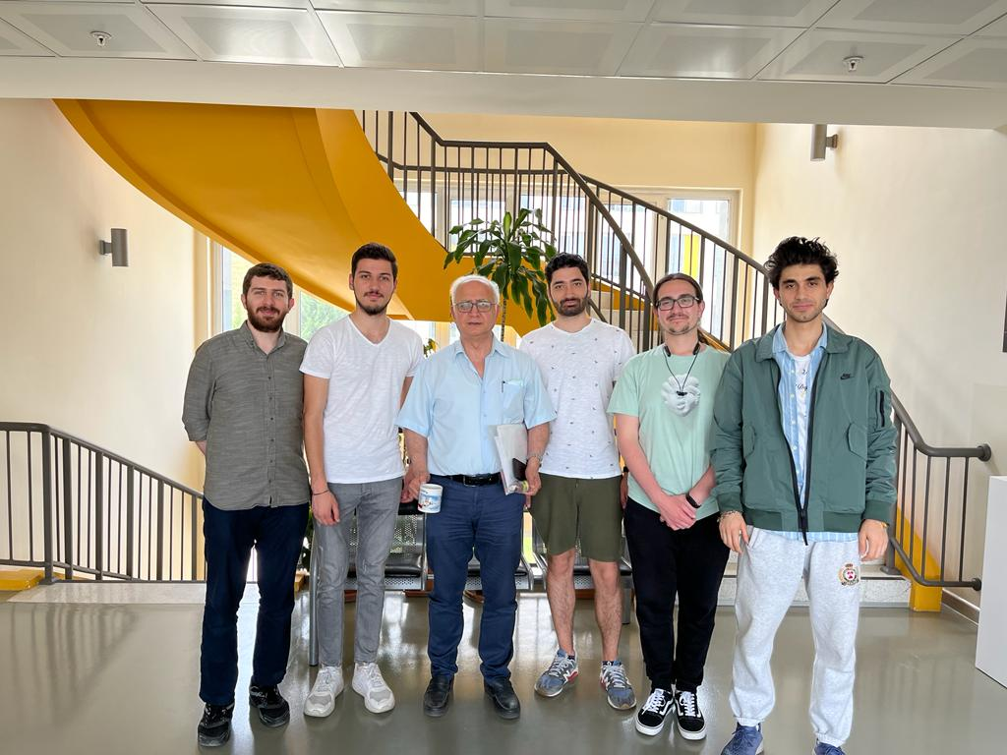
CENG 408 lıcence plate recognıtıon system Project presentatıon
TEAM MEMBERS
Mehmet Furkan turan
Arda kayış
Doğukan tutak
Burak çetin
Muhammed emin atalık
Advısor
Prof. Dr. Ahmet coşar

Slide 2
CONTENTS
Problem
Analysis - Methods of Licence Plate Recognition System
Similar Projects
Solution
Technology Used
Working Principle of the System
Work Distribution
Work Plan
Results and Conclusion
Demo

Slide 3
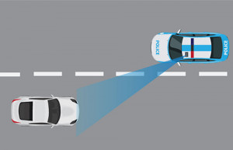
PrOBLEM
Police forces
Military areas
Traffic control
Keeping city entrances and exits under control
City security
Establishment of smart traffic systems

Slide 4
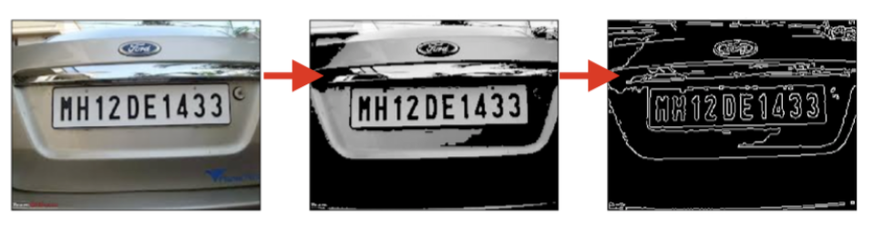
Analysıs – Methods of Lıcence Plate Recognıtıon System
Licence Plate Detection
Edge Based Methods
Colour - Based Methods
Texture Based Techniques
Character-Based Methods

Slide 5
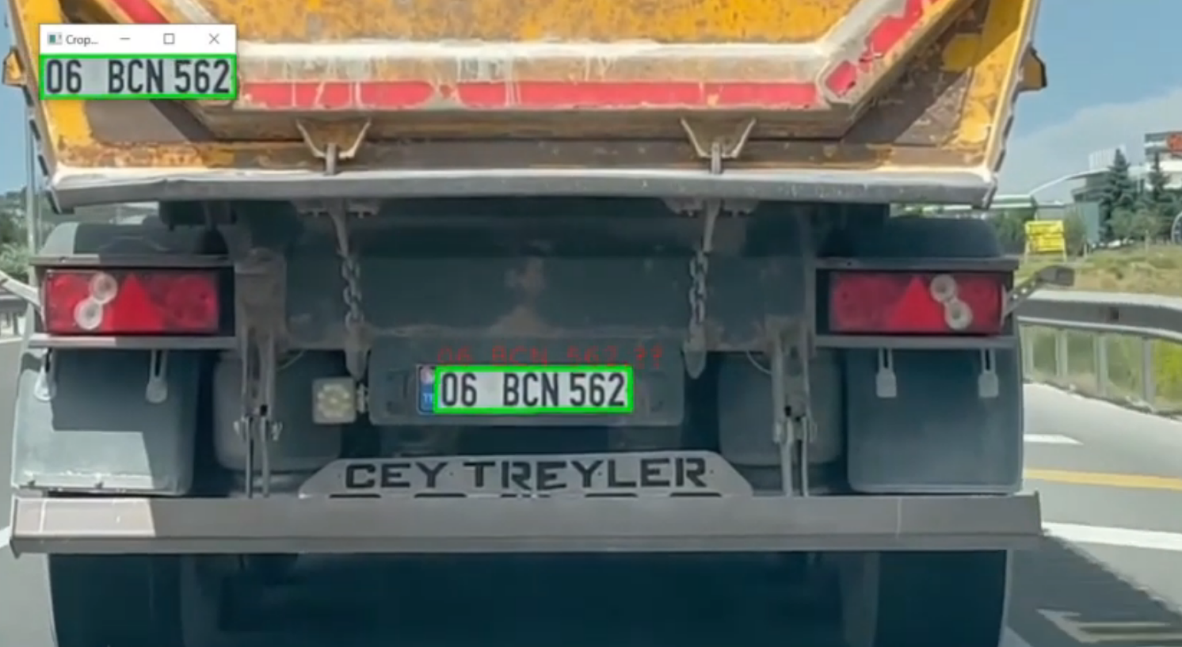
Analysıs – Methods of Lıcence Plate Recognıtıon System
Licence Plate Recognition
Pre-processing Techniques
Character Segmentation
Character Recognition

Slide 6



SIMILAR PROJECTS
ArmaKontrol
AXIS COMMUNICATIONS
NEUTRON

Slide 7
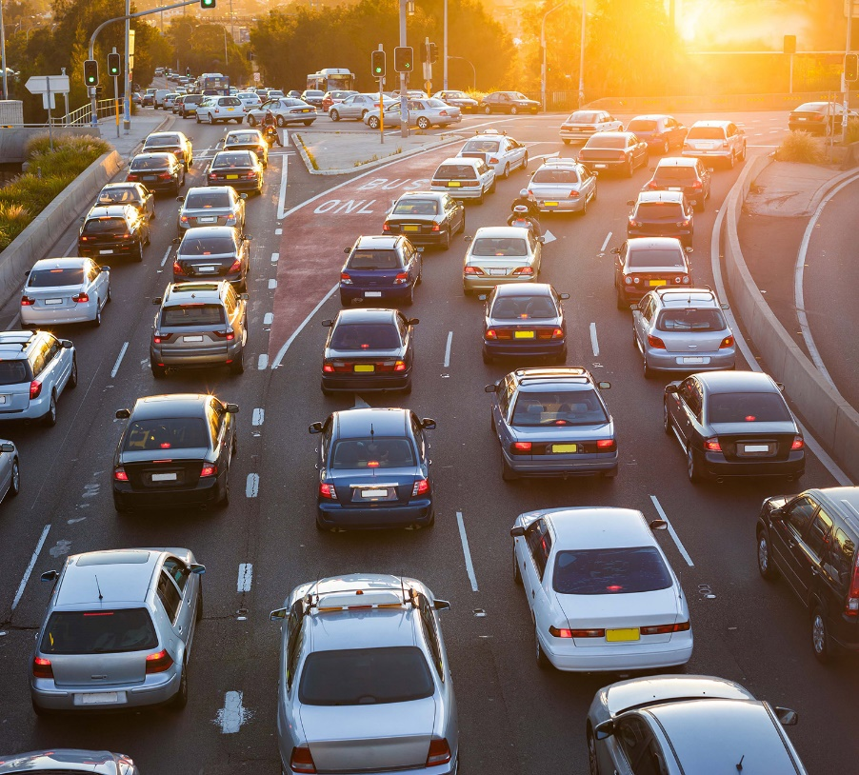
SOLUTION
License Plate Recognition System offers a solution that has been needed in recent years and necessary steps can be taken for the operation of an efficient smart transportation network.

Slide 8
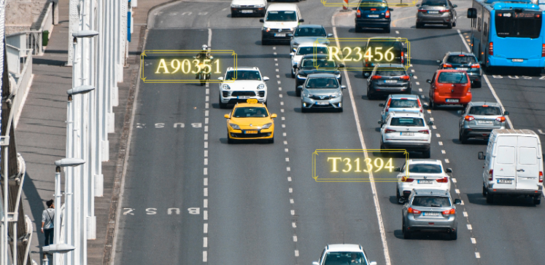
SOLUTION
This system consists of vehicle detection, license plate recognition. In the License Plate Recognition System project, deep learning methods are used for vehicle detection. For license plate recognition, it is ensured that the license plates of the vehicles are detected and the license plates are read by using image processing and OCR methods.

Slide 9


Technology Used
Python
Tesseract – The optical character recognition engine
OpenCV - The libray for license plate detection and character segmentation

Slide 10
WORKING PRINCIPLE OF LICENCE PLATE RECOGNITION SYSTEM
Detecting vehicles in video.
Convert video to grayscale.
Edge detection method is applied.
Compare and verify the side ratio and area of each bounding rectangle.
Image segmentation
Characters on the plate are recognized by using OCR.

Slide 11
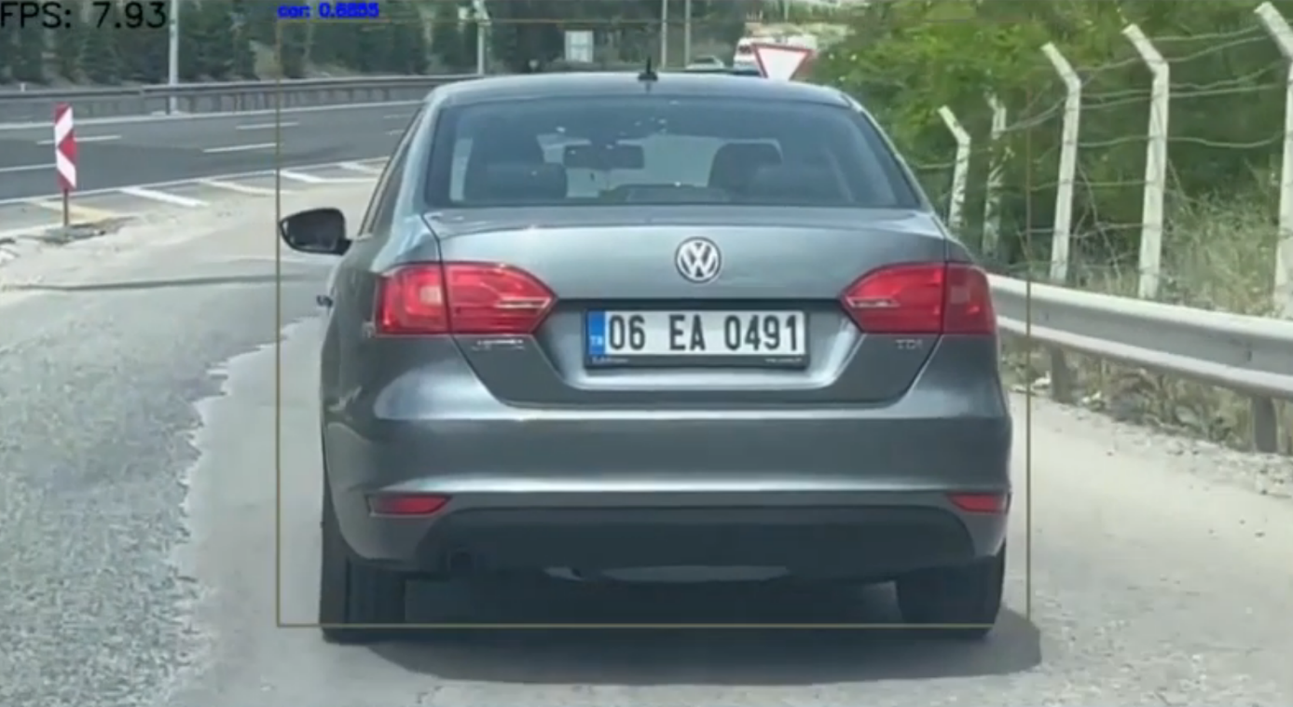
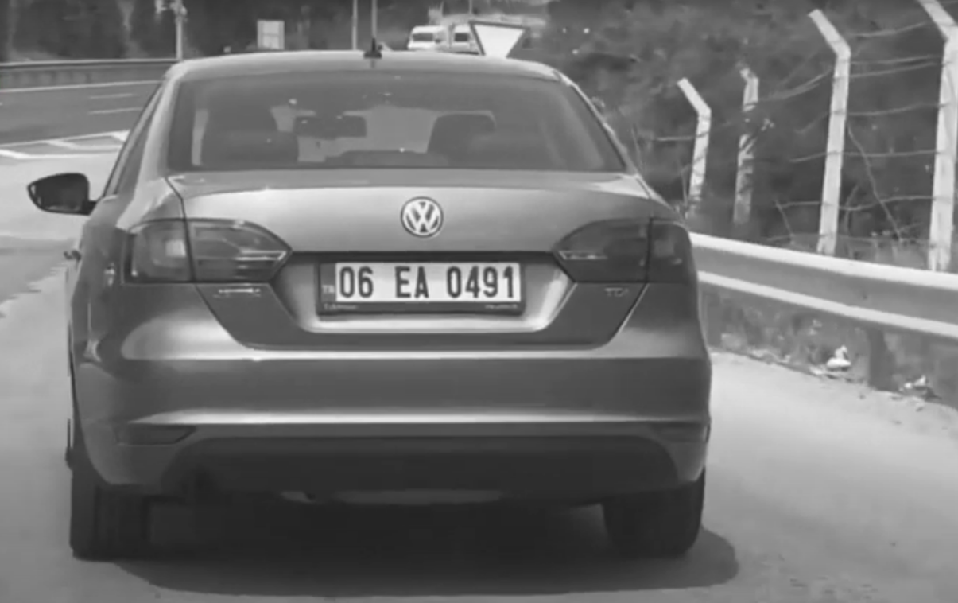

Slide 12
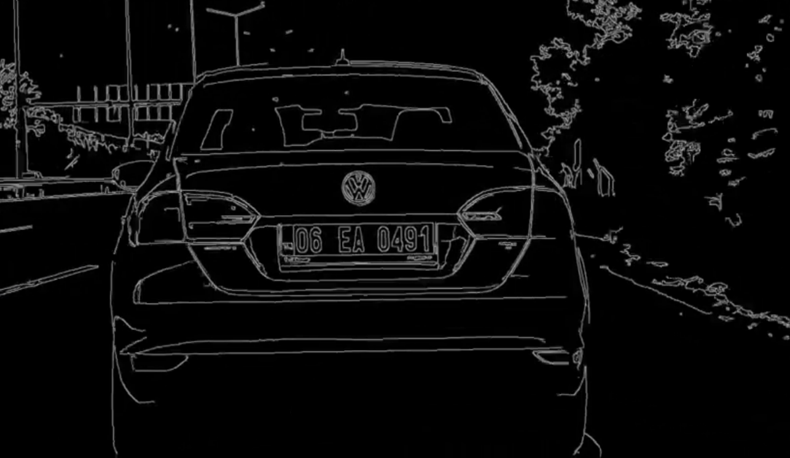
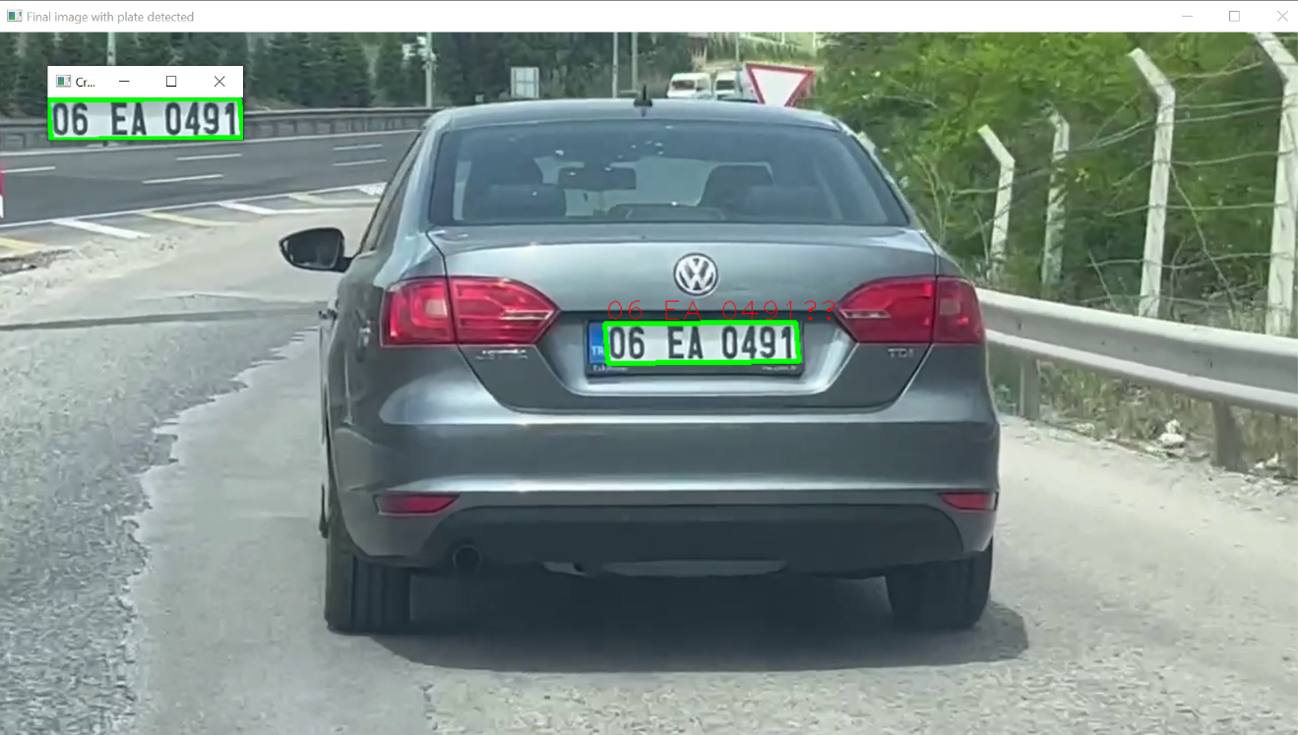

Slide 13
WORK DISTRIBUTION
WORKS | DONE BY
Vehicle Detection Software | Mehmet Furkan Turan, Doğukan Tutak, Arda Kayış
Licence Plate Recognition Software | Mehmet Furkan Turan, Burak Çetin
ESP32 CAM Connection and Circuit Design | Muhammed Emin Atalık, Mehmet Furkan Turan
Tests | Burak Çetin, Arda Kayış, Doğukan Tutak
Data Collection and Preprocessing | Doğukan Tutak, Muhammed Emin Atalık, Mehmet Furkan Turan
Researching and Analyzing | Arda Kayış, Burak Çetin

Slide 14
Work plan

Slide 15
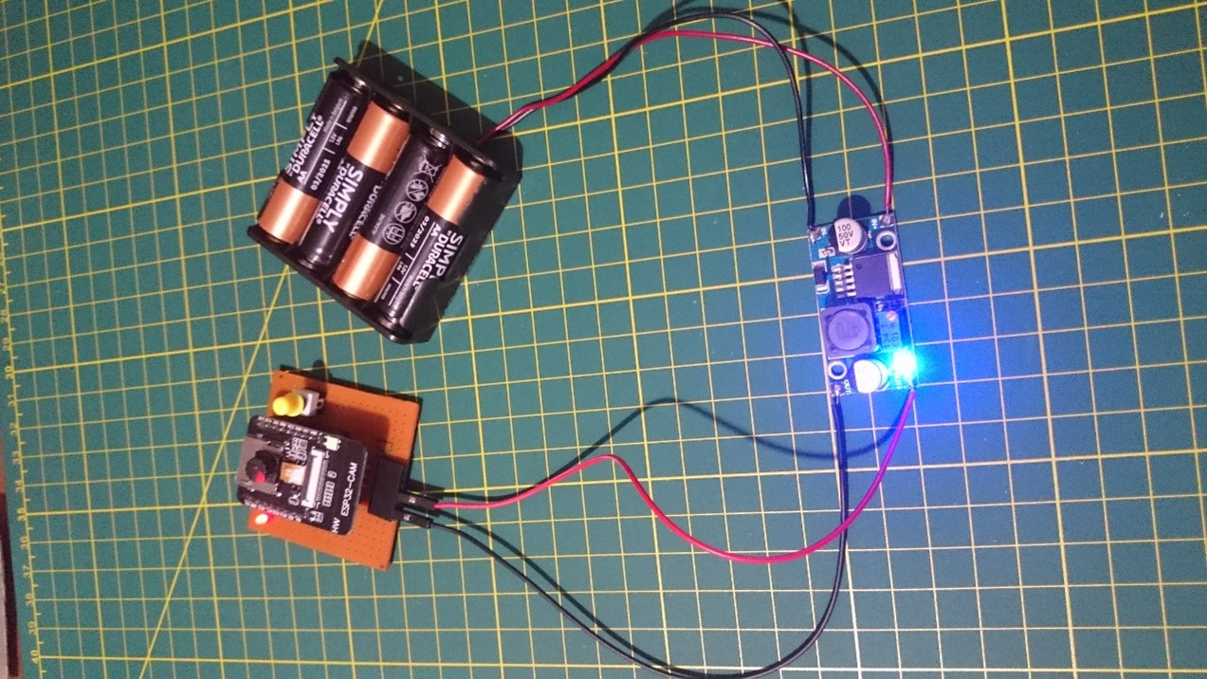
ESP32 CAM

Slide 16
conclusıon
In the License Plate Recognition System, vehicle recognition and license plate recognition software and OCR processes are performed by taking images of the vehicles through videos.This enables license plate recognition and vehicle detection software to work on captured images. By using deep learning method, vehicles are easily recognized, license plate characters are detected with OCR method and license plate recognition process is realized.

Slide 17
DEMO
CENG 408 Licence Plate Recognition System Demo Video - YouTube

Slide 18

THANK YOU FOR LISTENING

